Slide 1
Welcome!
(Your School) Hack Club - Interest Meeting
Grab a slice of pizza on your way in!

Slide 2
So… What exactly is Hack Club? Do I hack banks?
For the second question, No!
Hack Club is a global non-profit organisation that connects students interested in engineering and computer science together while also showcasing people the power of collaborative programming. Members have the opportunity to learn new skills and receive their ideas (or the tools to make that idea) in real life. Additionally, students can participate in global events, in-person or online. For example, Arcade was an event over the 2024 summer where students made awesome projects and won over $100,000 in prizes from Microsoft, Apple, Logitech, Prusa Research, Flipper Zero, Framework, and more!

Slide 3
Why should I join? Why not (other CS clubs)?
No deadlines, No stress
(Your school’s) Hack Club is as flexible as you are. It can be your main or side club. There’s no deadlines, no homework, no stress, just learning and building.
Work with your hands, not concepts:
You can’t learn carpentry without wood. Follow live lessons and develop skills that help you create and not just consume in a technical world.
Get free stuff (that you can keep!):
From Drawing Robots, PCBs, Gaming Consoles, 3D Printers, Boba, or a Frappuccino! Learn skills, build cool stuff and get rewarded!

Slide 4

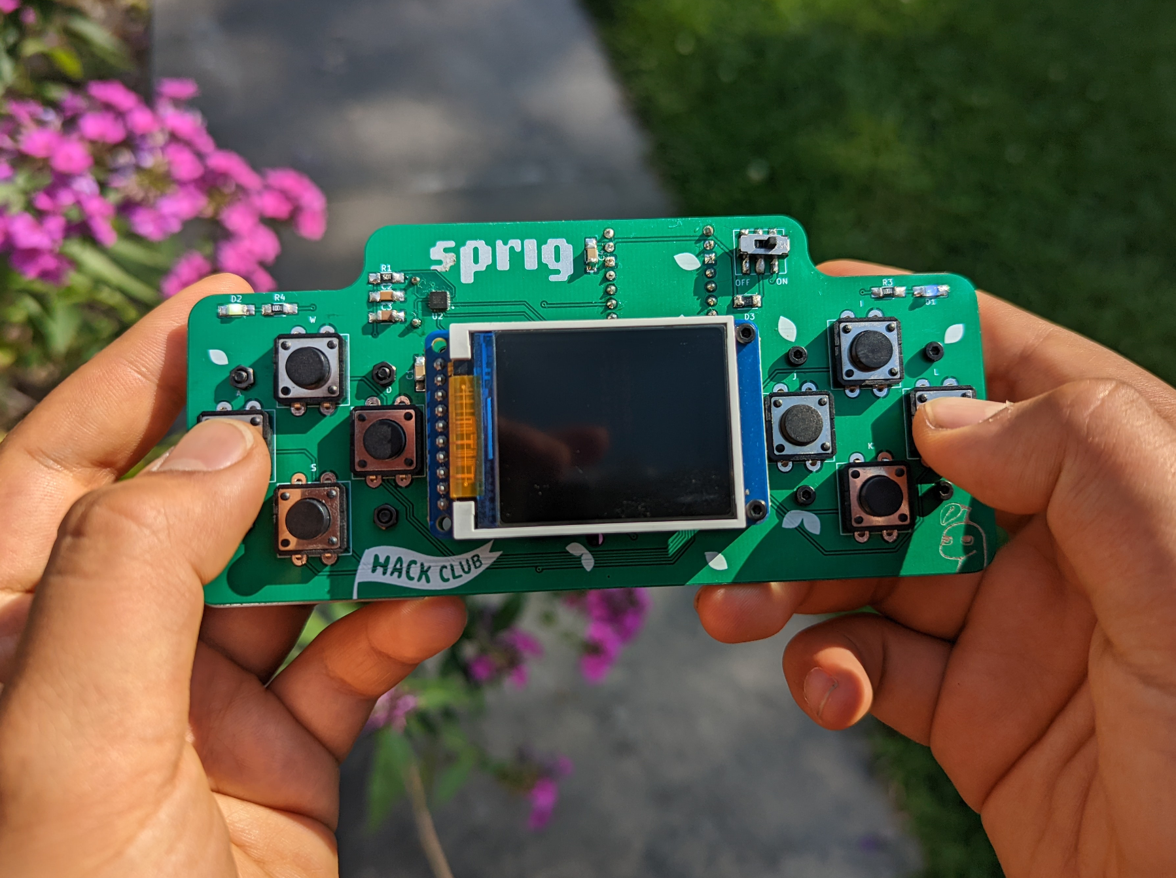
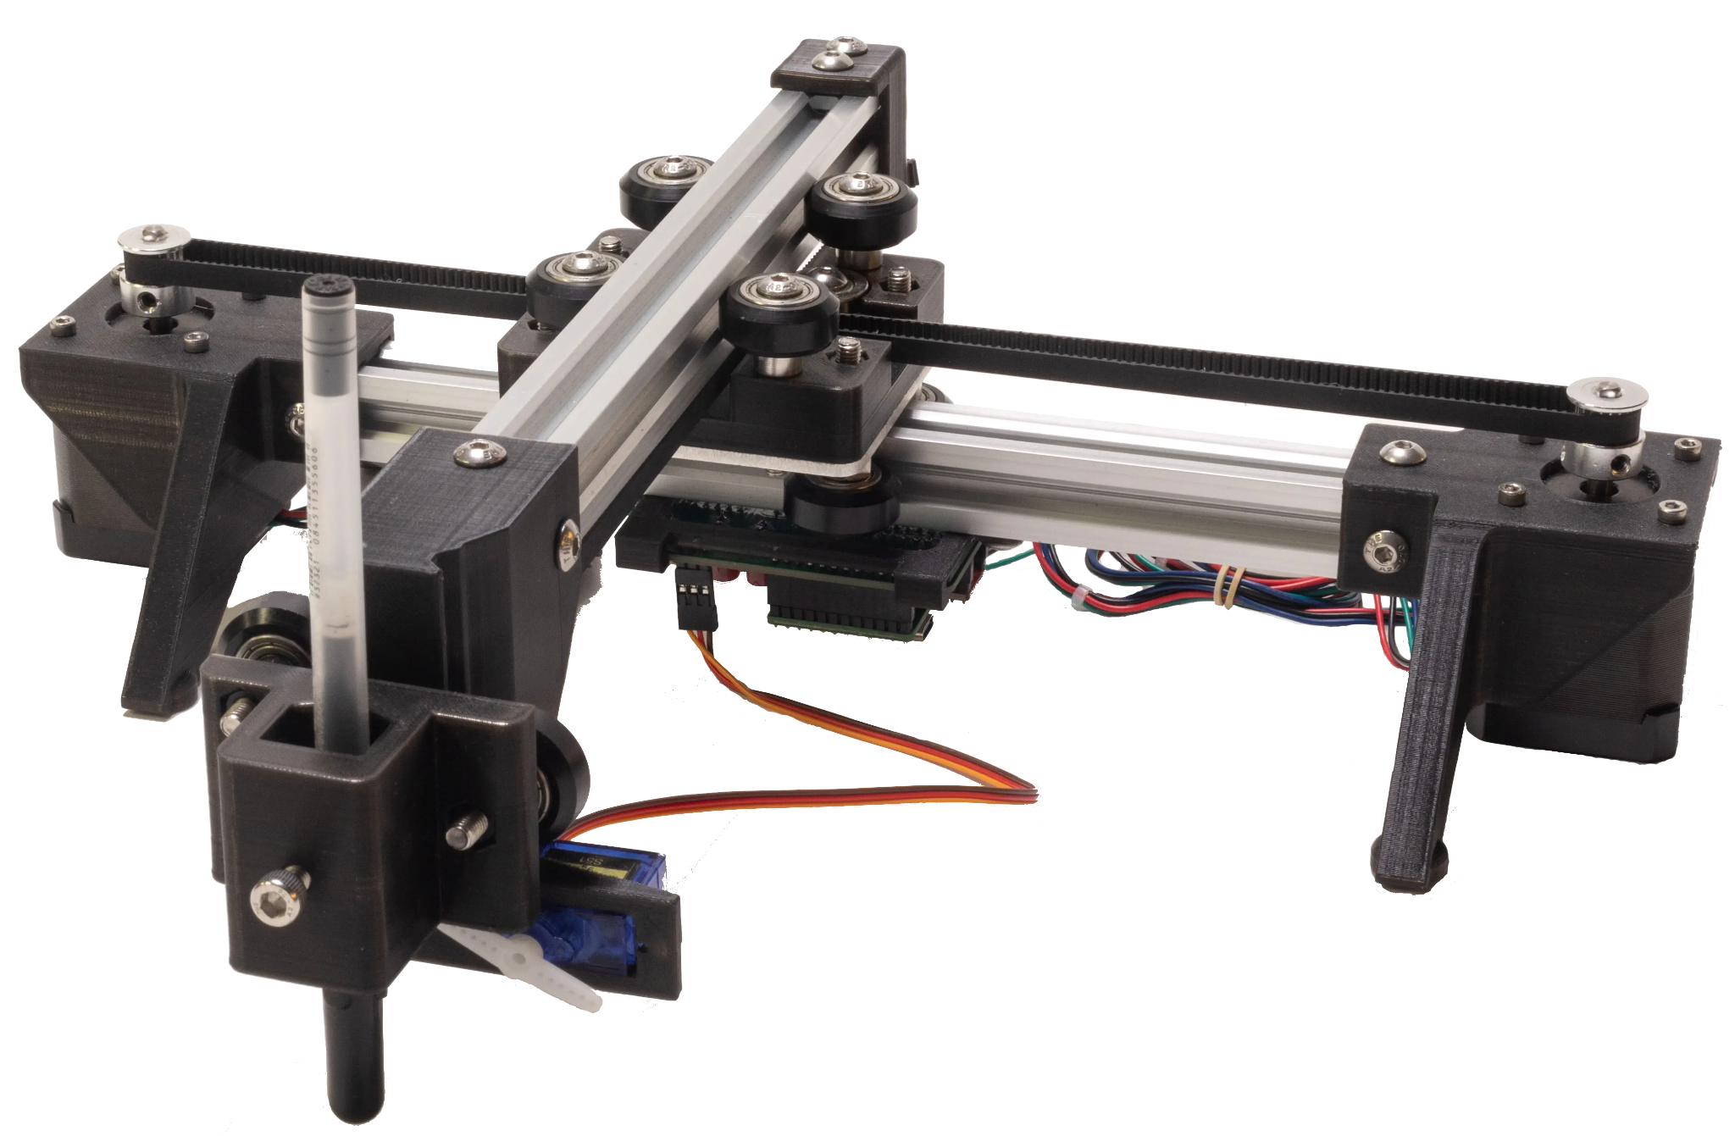
What can I get (for free)?
PCBs (OnBoard)
Handheld (Sprig)
Drawing Bot (Blot)
Get $100 to design a circuit board and get it produced and shipped to you!
Build a game, get a Raspberry Pi-powered gaming handheld to play it on!
Learn generative art, get a hackable drawing robot and see your art on paper!

Slide 5

How do I start?
Scan this QR code and download Slack on your phone.
Enter your email. Before the next meeting, make sure
You’re verified as a student and join the
#(club channel) channel on the Hack Club Slack.

Slide 6
Thanks for coming!
See you at the next meeting on ________ (08/XX/2X)
Grab a sticker on the way out!

